Slide 1
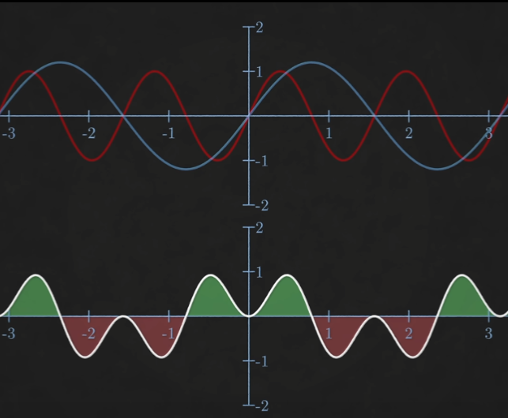
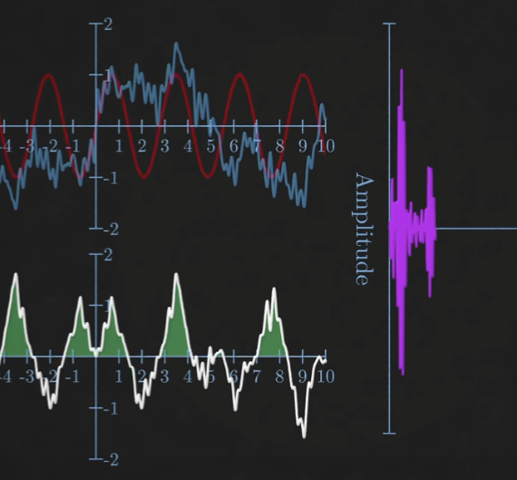
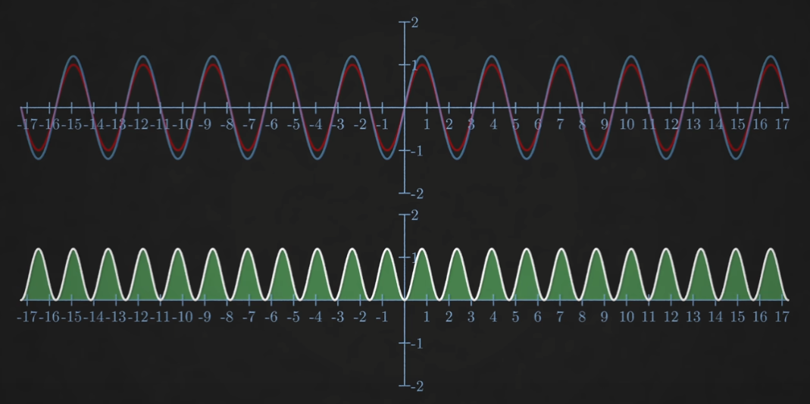
Halfway presentation: Fourier Analysis in Optical Coherence Tomography
Saban Caliskan
Research Internship

Slide 2

Fourier Transform
Linear Transformation
$\hat{f}\left(ξ\right)=\int_{−∞}^{∞}{f\left(x\right)ⅇ^{−ⅈ2πξx}ⅆx}$
$f_{inv}\left(x\right)=\int_{−∞}^{∞}{\hat{f}\left(ξ\right)}ⅇ^{ⅈ2πξx}dξ$
$e^{iθ}=\cos\left(θ\right)+i ∙\sin\left(θ\right)$
Peaks determine Periodicity and Shape
Source: https://en.wikipedia.org/wiki/Fourier_Transform
Source: https://en.wikipedia.org/wiki/Fourier_Series

Slide 3
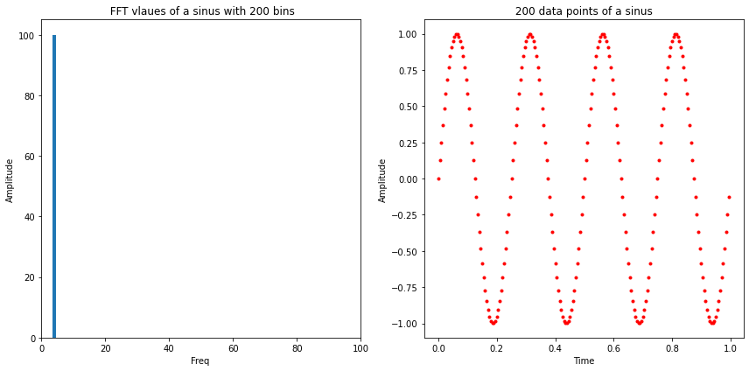
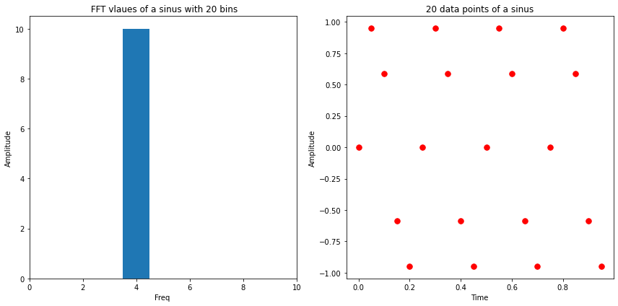
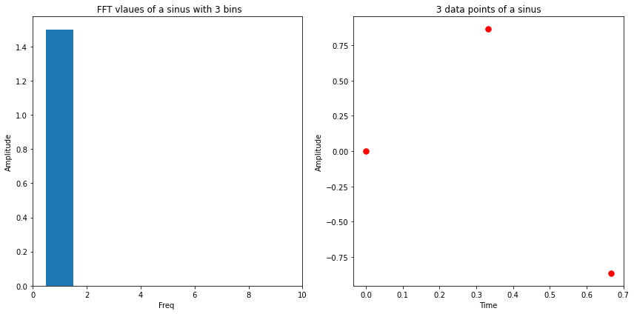

Discrete Fourier Transform
Discrete data
$X_{k}=\sum_{n=0}^{N−1}{x_{n}∙e^{−i\frac{2π}{N}kn}}$
All possible frequencies: $f_{n}=n\frac{1}{2T} , n∈[0, N−1]$
Nyquist Frequency:
‘the Nyquist frequency is the frequency whose cycle-length is twice the interval between samples’, i.e: at least 2 samples
Computation $∝N^2$

Slide 4
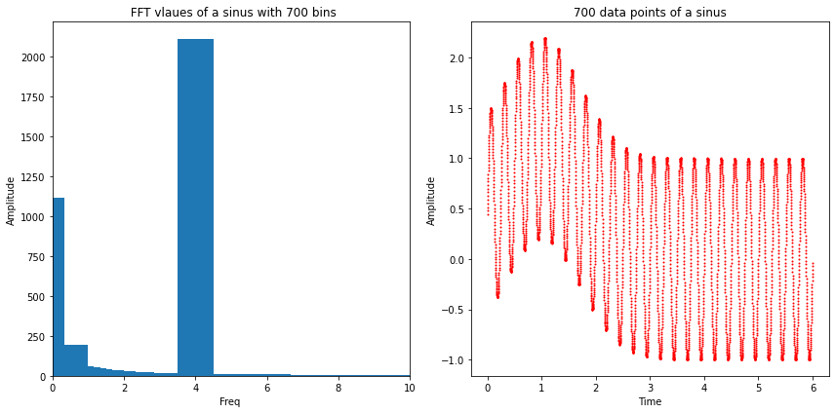
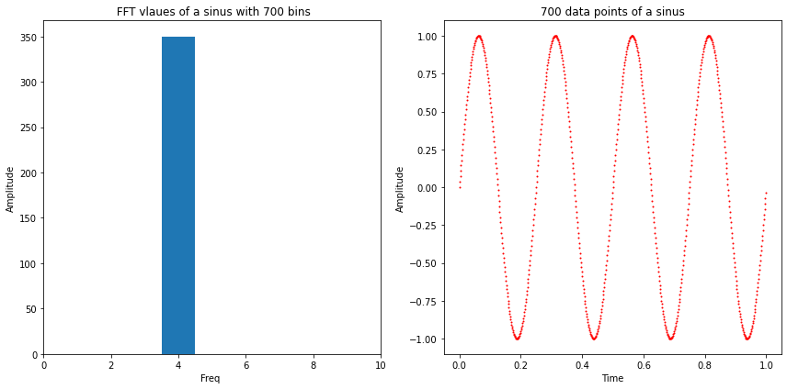
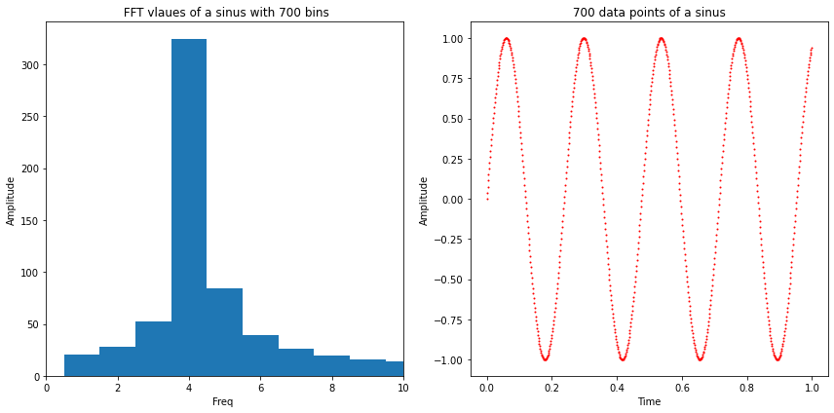
What is our goal?
Reflected spectrum modulated because of interference
FFT peak corresponds to thickness of sample
Need to find the exact location of the peak in FFT
What if the exact frequency is not exactly in the centre of a bin?

Slide 5
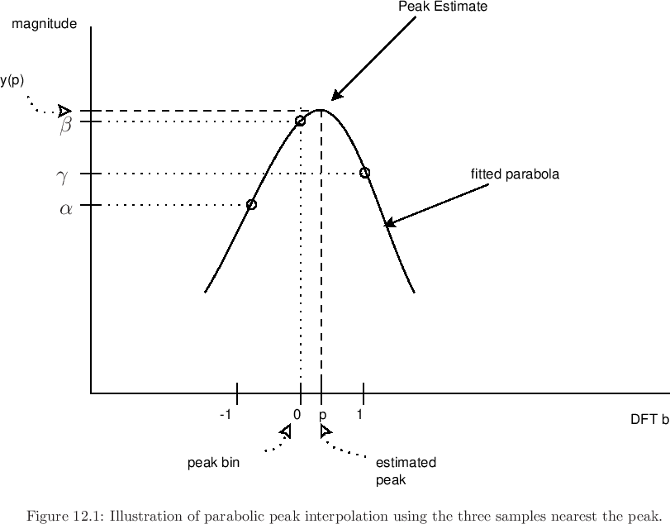
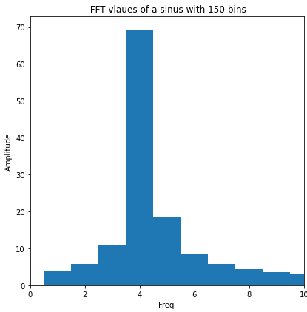

Peak Fitting
2 Methods to interpolate the exact frequency
To determine the Exact location
Quadratic approach:
$y\left(x\right)={−a(x−p)}^{2}+b$ $p= \frac{1}{2}\frac{y\left(−1\right)−y(1)}{y\left(−1\right)−2∙y(o)+y(1)}$
2. Barycentric approach:
Weighted average $p= \frac{∆Y}{Y_{1}{+ Y}_{2}{+Y}_{3}}$ = $\frac{Y_{1} −Y_{3}}{Y_{1}{+ Y}_{2}{+Y}_{3}}$

Slide 6
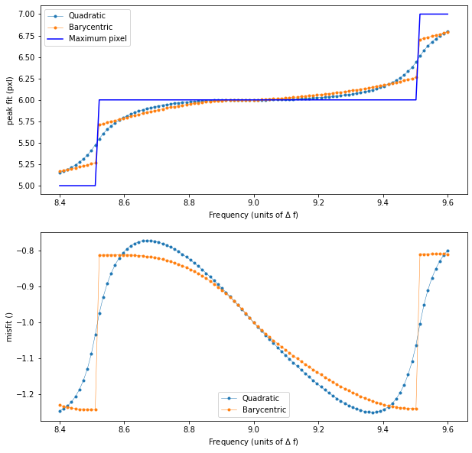
More Newer methods
Result for pure sine of 99 different frequencies between 8.4 and 9.6 Δf = 1/350, N = 700.
3. Quadratic approach:
Continous
Large misfits
4. Barycentric approach:
not continous.
Large misfits

Slide 7
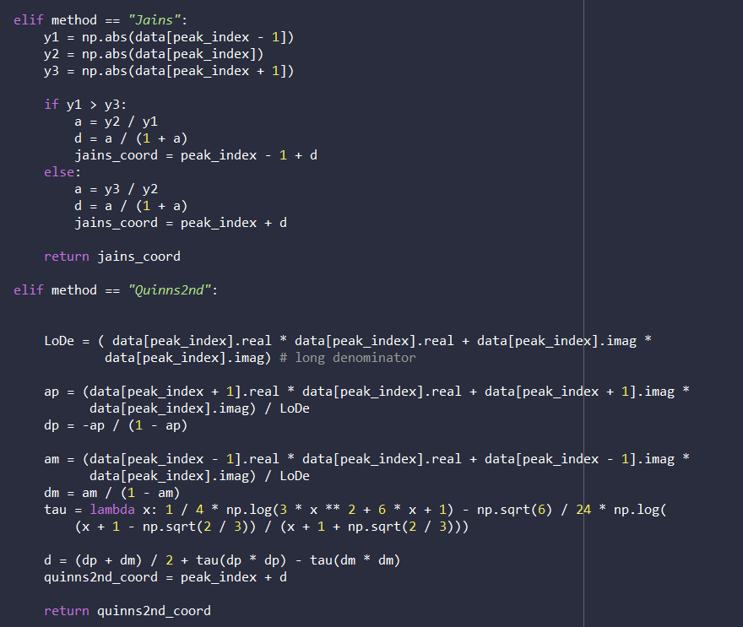
More Advanced Methods
3. Jain’s method
4. Quinn’s (2nd) method

Slide 8
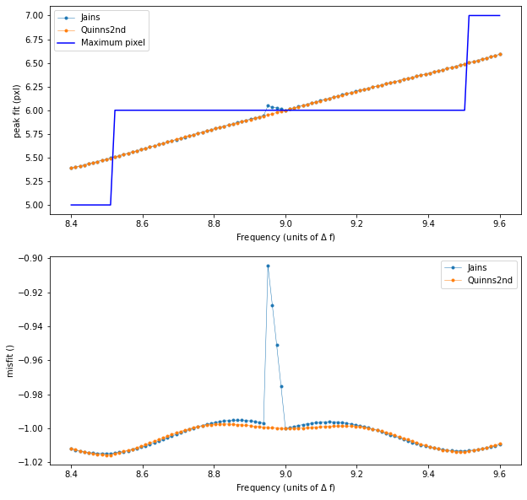
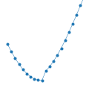
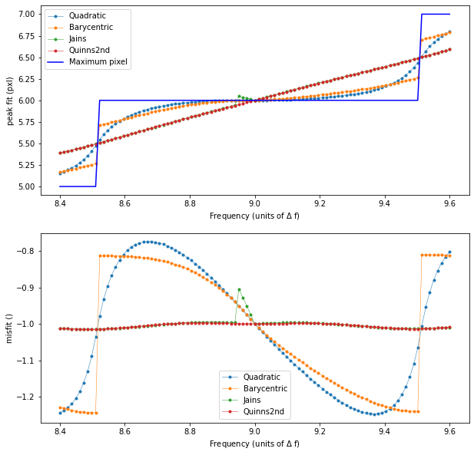
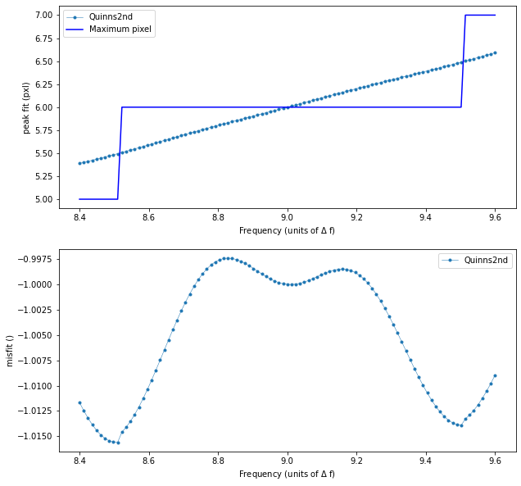
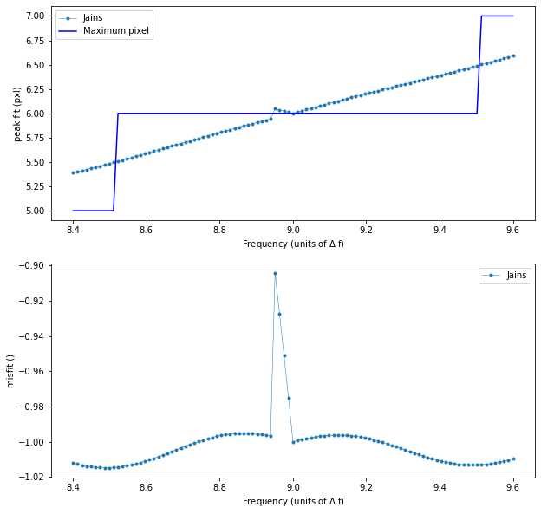
Result Jain’s and Quinn’s
Generally Better
Neither is Continous

Slide 9
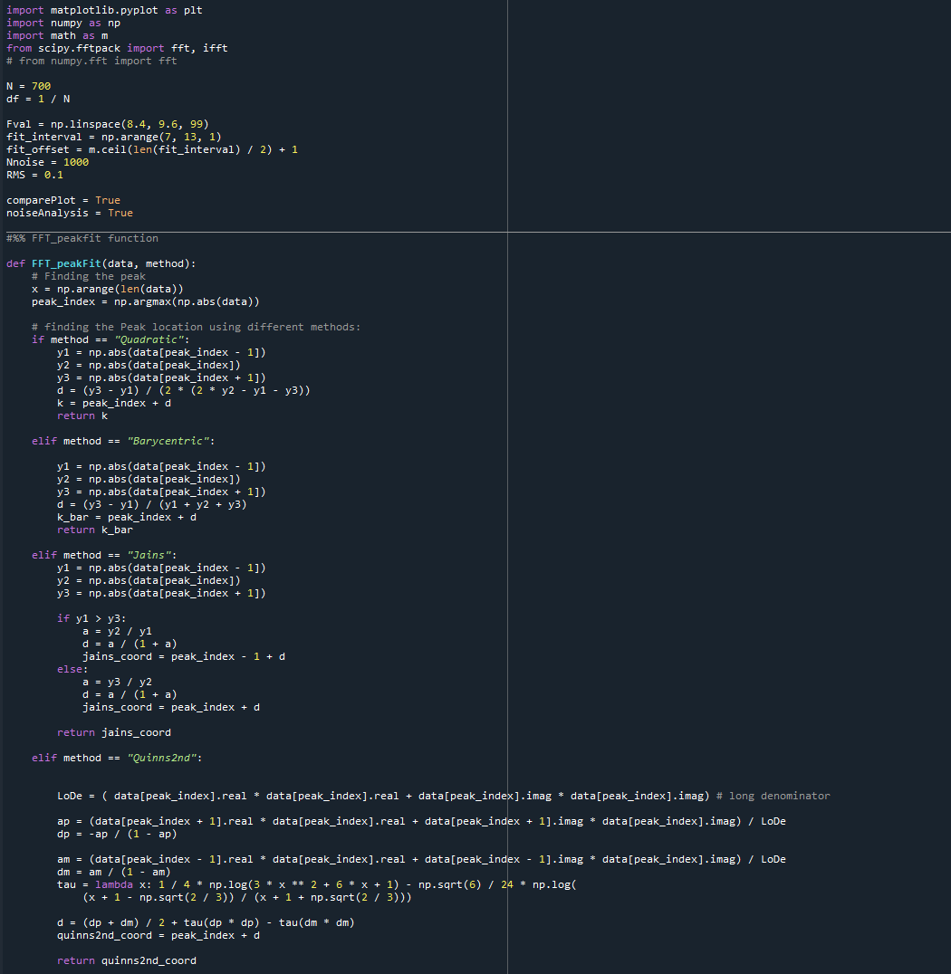
Outlook
Impact of noise on fit
Impact of phase differences on fit
Continuous Quinn’s and Jains

